Slide 1
SMART DRONES
BY -:
BEYONDER(S)

Slide 2
Introduction
What is Drone?
In aviation and in space, a drone refers to an unpiloted aircraft or spacecraft. Another term for it is an "unmanned aerial vehicle," or UAV.
Over the past few years, drones have become central to the functions of various businesses and governmental organizations and have managed to pierce through areas where certain industries were either stagnant or lagging behind. From quick deliveries at rush hour to scanning an unreachable military base, drones are proving to be extremely beneficial in places where man cannot reach or is unable to perform in a timely and efficient manner.
Why we need them?
Drones, a mechanical marvel have become an integral part of our life. They are used in almost every sector, from military to farming, from surveillance to recreational activities, thus covering all possible angles. For example in military sector drones are used for surveillance, for attacking and so on. Also this technology is becoming increasingly popular among common people. Its application has vastly affected the day to day lives such as in the farming sector drones are used for spraying pesticides as well as analyzing the state of crops, in the educational sector drones have become a famous recreational target of young engineers.
Even taking the live example of today’s global pandemic of Corona Virus (aka COVID19) drones are proving to be the most useful technology, from delivery to surveillance, they’re being used everywhere keeping the social distance.

Slide 3
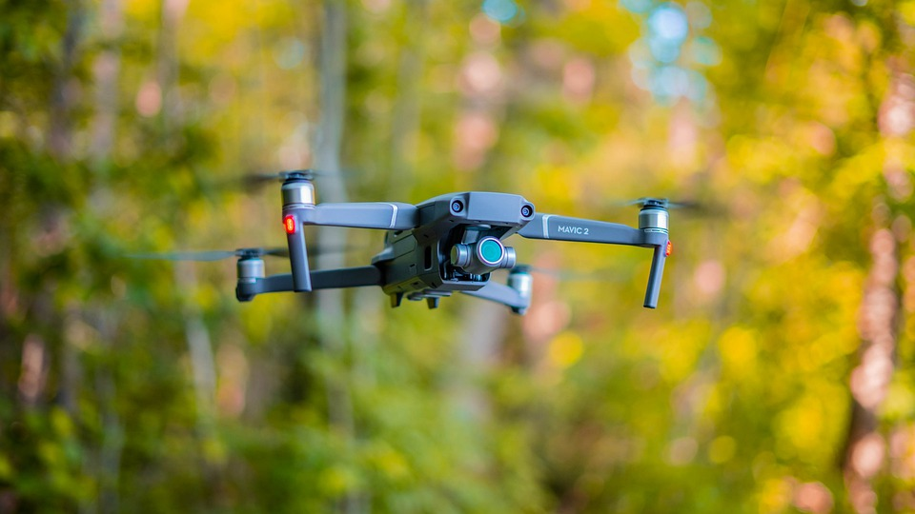
AIM
Our aim is to make the drones smarter.
By upgrading their software(s) and hardware(s) to make them all ready for the 7th generation drones.
Specifically customized according to it’s user needs.

Slide 4
OBJECTIVE
Our objective is to make the drones future ready & make them more efficient and autonomous, with various safety protocols and anonymous features. Our approach is completely user driven.
Currently there are 7 Generations of drones, from which most of the drones being used today are from 5th & 6th Generation. We focus on making all the drones with 7th Generation Technology
How we plan to achieve that?
We plan to make the drones fully autonomous, using satellite(s) for keeping a track and communicating with the drone.
We are also going to use various Machine Learning Codes to make safety protocols to avoid all possible damages.
We plan to make an Artificial Intelligence with significant sensors to make the drones able to find most efficient routes to their destinations.
We are aiming to upgrade the hardware for more speed, reliability, strength & to optimize it to be more power sufficient.
We also plan to make user specific customizations in every domain to give the users the best experience.

Slide 5
Diagram(s)
Entity Relation Diagram (ERD)
Data Flow Diagram (DFD)
Pert Chart Diagram
Class Diagram
State Chart Diagram
Development Process/Architecture Diagram

Slide 6
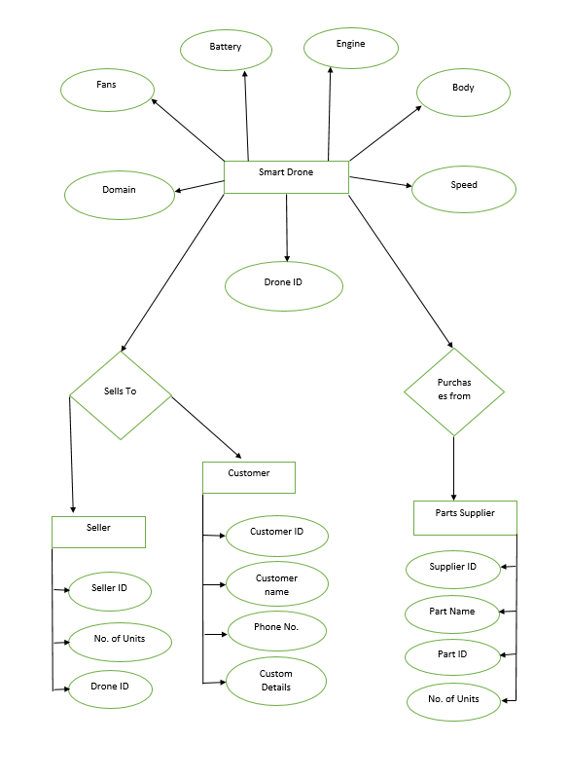
E-R DIAGRAM

Slide 7
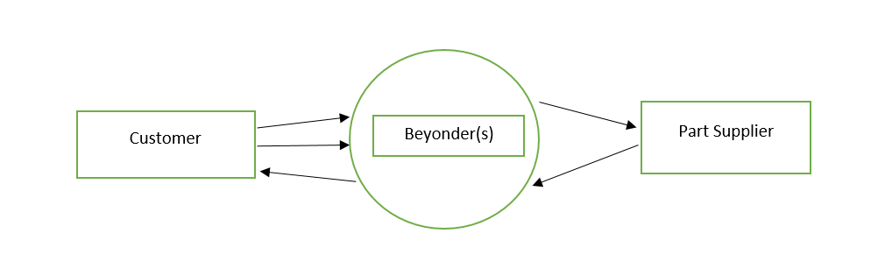
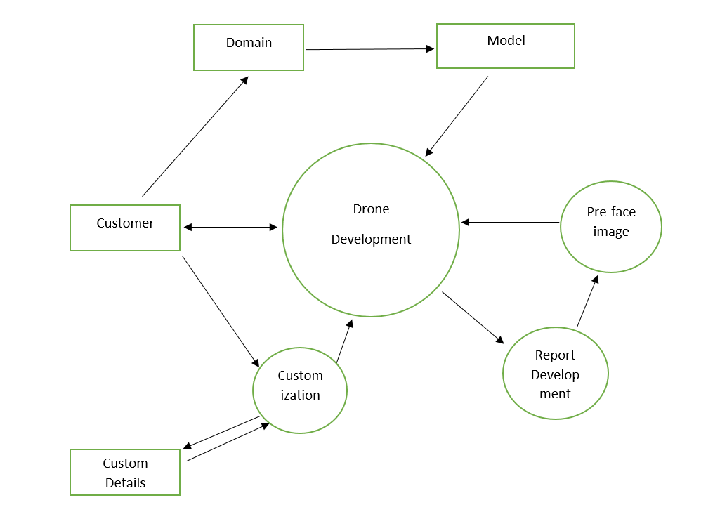
DATA FLOW
DIAGRAMs
DFD LEVEL 0
DFD LEVEL 1

Slide 8
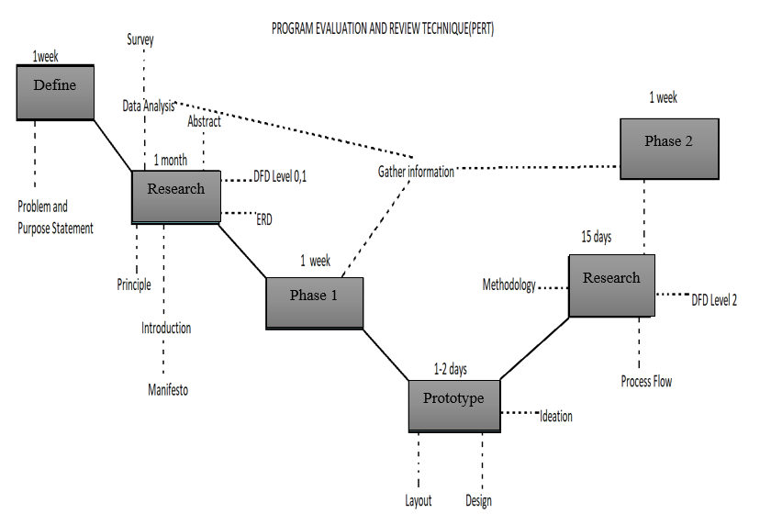
PERT
CHART
DIAGRAM

Slide 9
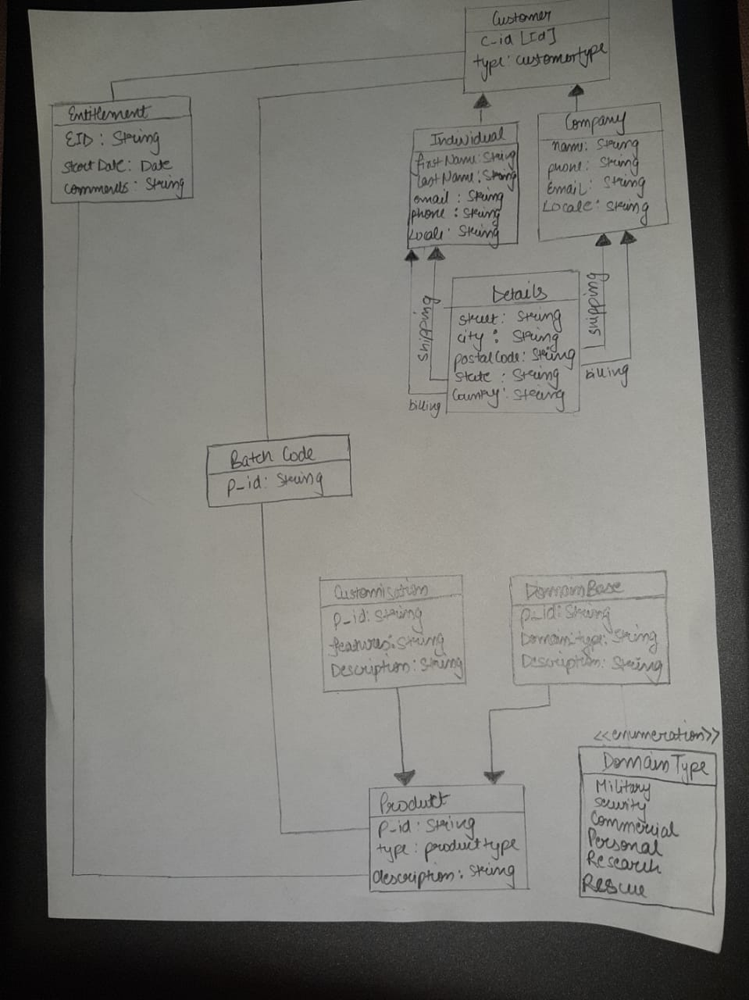
CLASS DIAGRAM

Slide 10
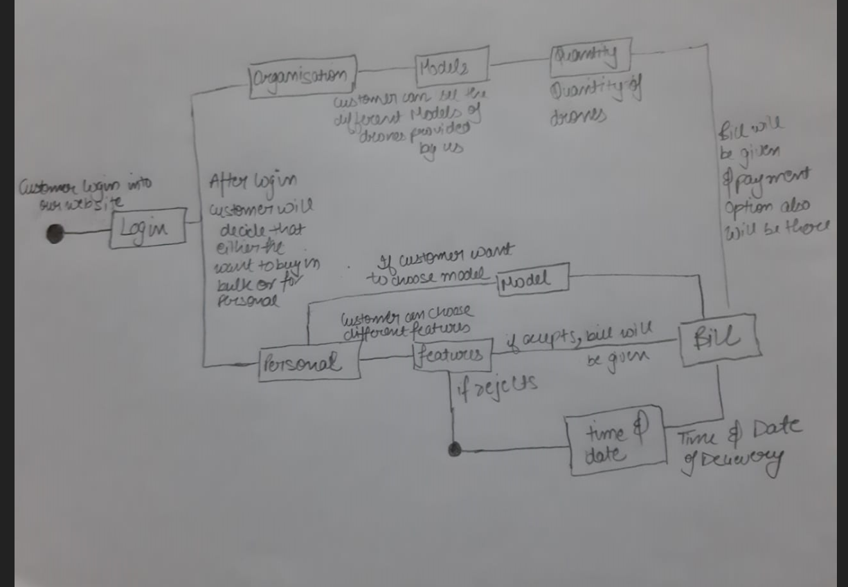
STATE
CHART DIAGRAM

Slide 11
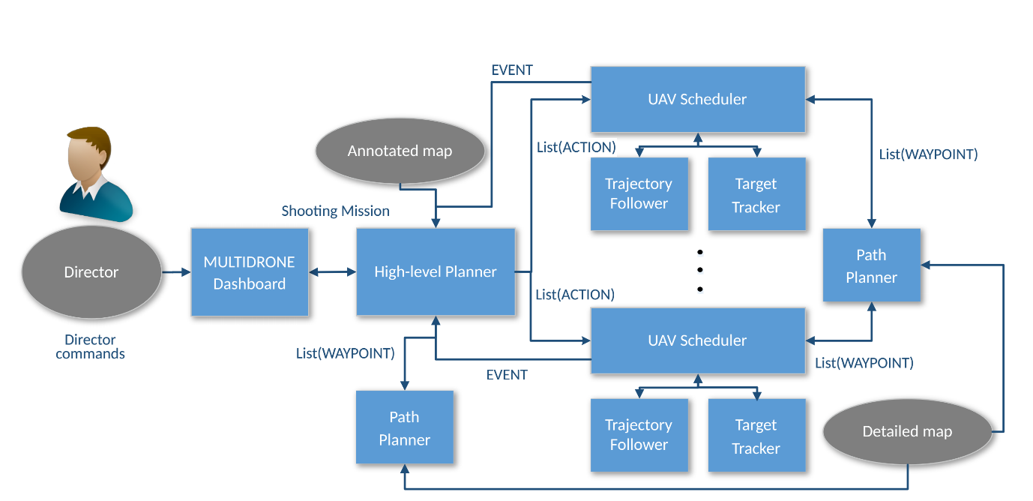
Architecture

Slide 12
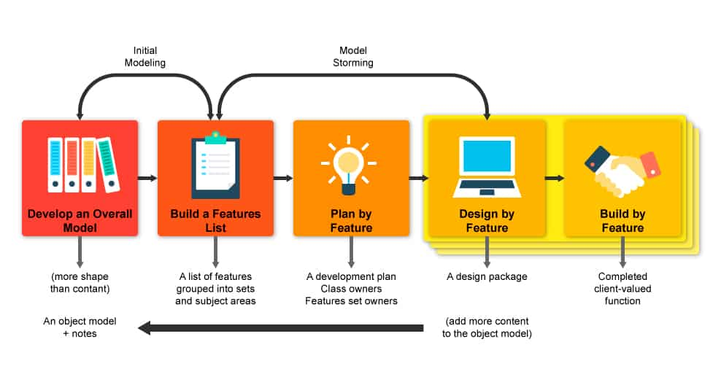
METHODOLOGIES
.
Methodology used in this project is FDD i.e. Feature Driven Development. FDD is a client-centric, architecture-centric, and pragmatic software process. Which makes it the idol methodology for our project as we want a customer driven approach, also we plan to make it feature by feature.
This methodology’s main factors is as follows:-
a) Develop an overall model
b) Build a feature list
c) Plan by feature
d) Design by feature
e) Build by feature

Slide 13
PROJECT PLANNING AND CONTROL
Project planning is an organized and integrated management process, which focuses on activities required for successful completion of the project. It prevents obstacles that arise in the project such as changes in projects or organization's objectives, non-availability of resources, and so on. Project planning also helps in better utilization of resources and optimal usage of the allotted time for a project.

Slide 14
Development process
We at Beyonder(s) have keen interest in developing a drone that can be used in combats and for defense purposes. We have focused on basically on how drone can be faster and self-capable on itself and have less of human interaction for which we intend to apply these in our project
Self-Routing Algorithm
Safety protocols
Dodging System
Stable flight patterns
REQUIREMENT ANALYSIS
Drone
Developer
Sensors
Chip-set and motherboard
Controller
Receiver and transmitters
GPS module
ARCHITECTURE

Slide 15
Target Audience
Military-: Military usage of drones has become the primary use in today's world. Used as target decoys, for combat missions, research and development, and for supervision, drones have been part and parcel of the military forces worldwide. Mainly military drones can be used in three ways like for attacking purpose, for spying purpose, for defensive purpose.
Security-: Security drones are mainly used by the company or hotels or government offices for the supervision and the drones are small in size so that they cannot be seen or even they make less noise.
Commercial / Industry-: Commercial drones have become a very important and time managing tool in industries. They are used for uplifting the heavy products from one place to another place. They’re also being used for delivery. Even in some industry small drones are used for supervision of the machines.
Personal Use -: Personal drones have taken place of many entertainment devices, people are getting drones for almost everything, from racing to photography. Like now-a-days in marriage we see many people use drones for making for videos, even in films drones are being used for taking high altitude shots, most of the bloggers used drones for the video. Even drones are used in racing tournament for videography and people are conducting drones racing tournament which is going crazy.
Research-: Research drones are being used to make archaeological discoveries. These drones are small that’s why they can reach where the human body cannot reach and are very helpful in finding.
Rescue-: Rescue Drones are being used in many hazardous situations, to supply necessary goods and to rescue people/animals from places man can’t reach.
Consumer Specific-: In this customer have to tell their idea about the drone what type of drone they want and what specific features they want. According to the customer view the drone will get developed and last test will be done by the customer itself.

Slide 16
